Slide 1

Title: Vehicle Breakdown Detection and Assistance System
Student Name: J. Hansika
Student ID: 2520030060
Cluster:1
Section: 2
Under the Guidance
of
Supervisor Name: xxxxxxxx
Assistant Professor
Department of CSE

Slide 2
Abstract
The Smart Vehicle Breakdown Assistance System is designed to help drivers during vehicle breakdown situations by providing quick and reliable roadside support. The system helps users locate nearby mechanics quickly by using GPS technology to detect the user’s current location. It displays nearby mechanic shops through Google Maps and also provides important emergency contact numbers for immediate assistance. An AI-based assistant is included to offer basic troubleshooting suggestions for common vehicle problems. The system integrates Data Structures and Algorithms in the backend to manage and process data efficiently. Overall, this system improves roadside safety, reduces waiting time, and provides convenient assistance to drivers during emergencies.

Slide 3
Existing System
Drivers search mechanics manually
No centralized system for roadside assistance
Difficult to find nearby mechanic quickly
Time consuming during emergency situations
Lack of instant support and information
No intelligent assistance for vehicle problems

Slide 4
Proposed System
Smart web application for vehicle breakdown support
Detects user location automatically
Shows nearby mechanics using Google Maps
Displays mechanic contact numbers
Provides AI based troubleshooting suggestions
Uses DSA algorithms for efficient data processing
Fast and user friendly interface

Slide 5
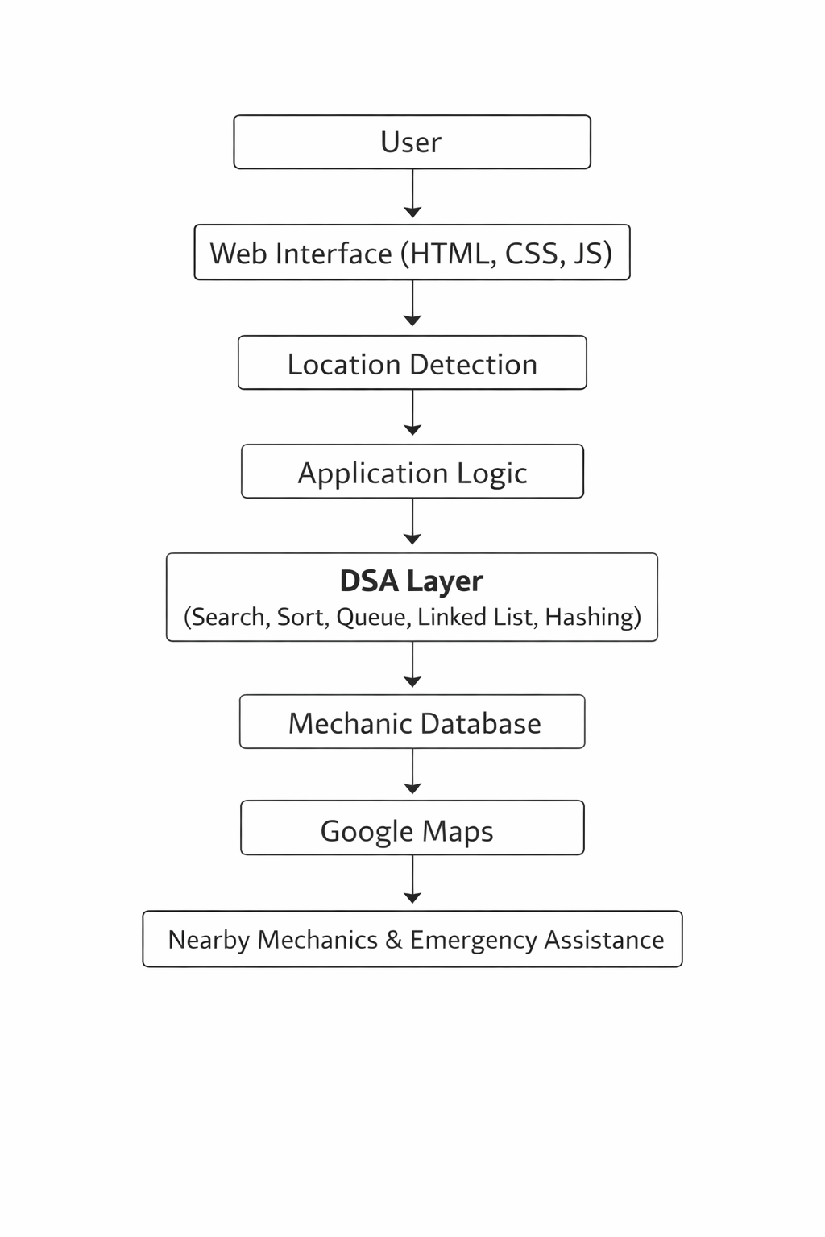
System Architecture

Slide 6
Project Modules
User Location Detection Module
Nearby Mechanic Search Module
Emergency Assistance Module
AI Vehicle Assistant Module
Mechanic Database Management
Data Structures Implementation Module

Slide 7
Objectives
Provide quick roadside assistance
Help users locate nearest mechanics
Reduce delay during vehicle breakdown
Implement Data Structures for efficient processing
Improve accessibility of emergency services
Develop a user friendly smart assistance platform

Slide 8
Co’s Attainments - FWD
CO1
Applied Internet and Web fundamentals
Implemented HTML document structure
Used headings, paragraphs and links
Applied basic CSS styling and typography
CO2
Designed HTML forms for user input
Used semantic HTML tags for structured content
Implemented CSS layouts using Flexbox
Created responsive design using media queries

Slide 9
Co’s Attainments - FWD
CO3
Implemented JavaScript fundamentals
Used conditions, loops and functions
Worked with arrays and objects
Processed user input dynamically
CO4
Implemented DOM manipulation
Handled JavaScript events
Implemented browser storage concepts
Used asynchronous programming concepts
CO5
Implemented form validation using JavaScript
Integrated Google Maps API
Optimized webpage performance
Applied deployment concepts and SEO basics

Slide 10
Co’s Attainments - DSA
CO1
Understood algorithm analysis and time complexity.
Implemented Linear Search and Binary Search in Java.
Compared searching algorithms for efficiency.
CO2
Implemented sorting algorithms.
Used Bubble Sort and Merge Sort.
Organized mechanic data for better processing.
CO3
Implemented List ADT using Linked Lists.
Used Singly Linked List to store mechanic data.
Performed insert and traverse operations.

Slide 11
Co’s Attainments - DSA
CO4
Applied Stack and Queue data structures.
Used Queue for service request management.
Demonstrated basic stack operations.
CO5
Implemented Hashing for mechanic data storage.
Used Priority Queue for nearest mechanic selection.
Enabled fast data retrieval.

Slide 12
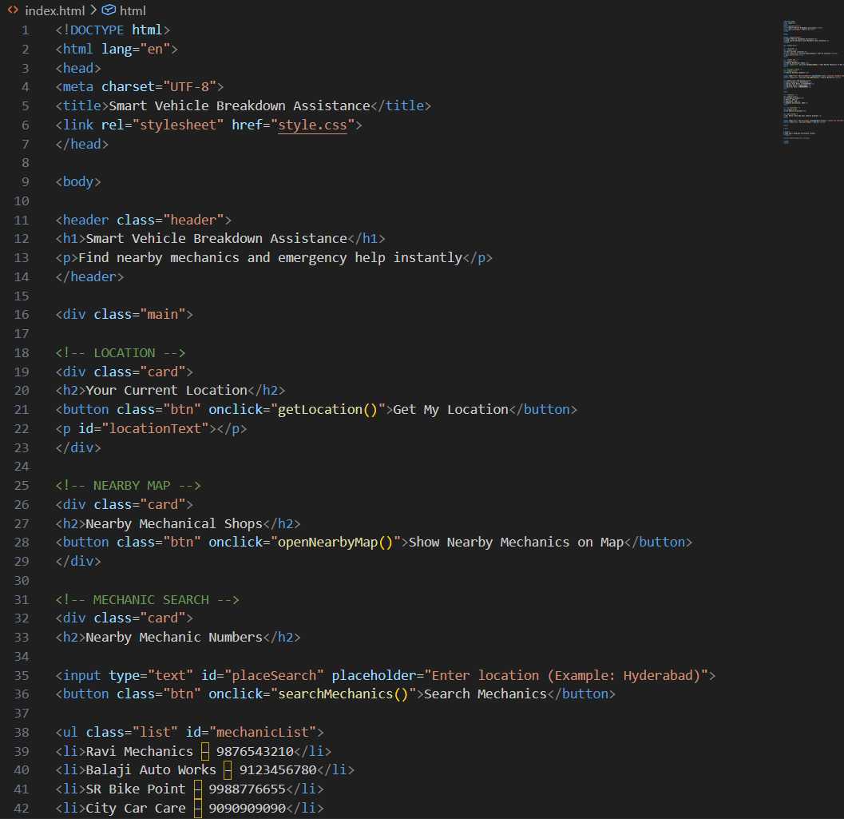
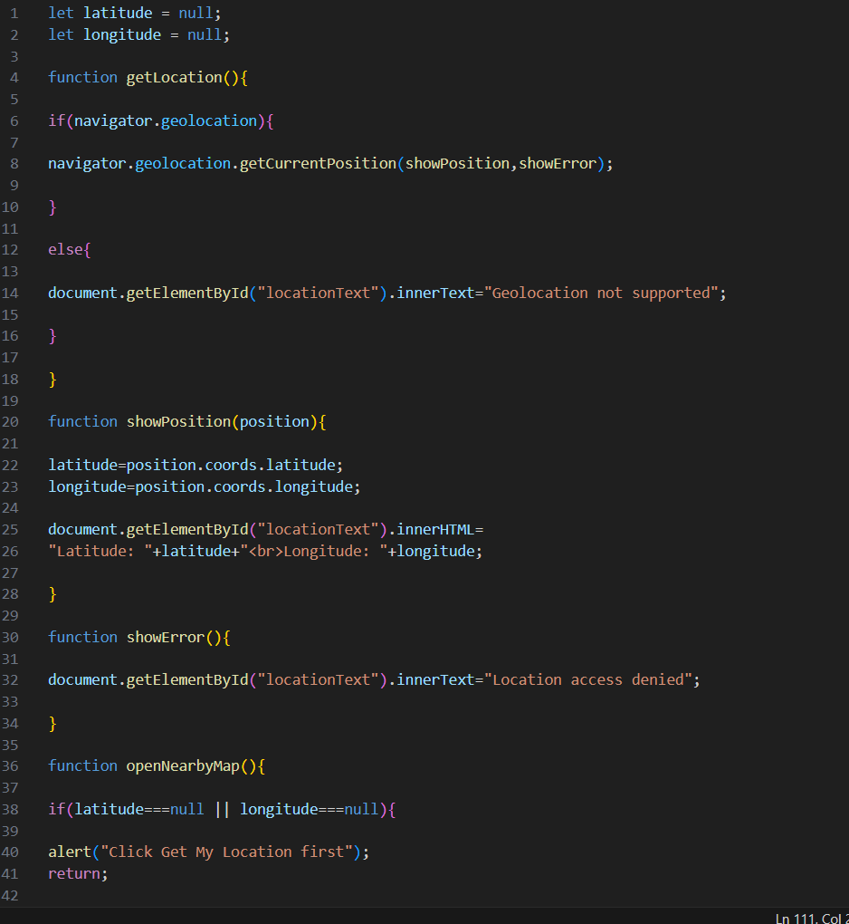
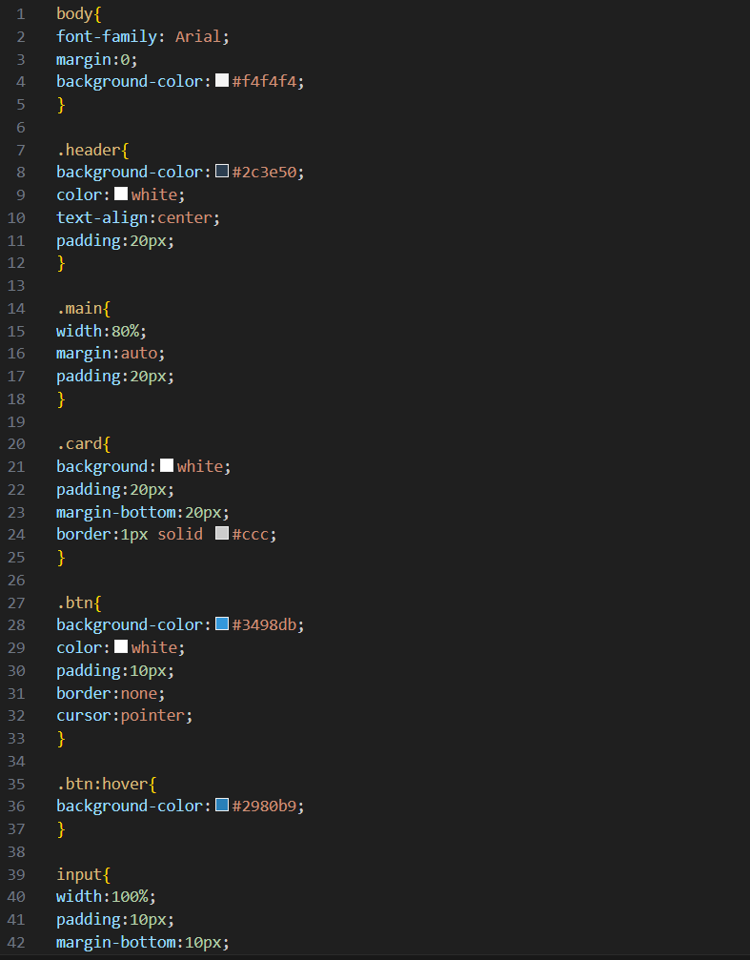
Screenshots for FWD

Slide 13
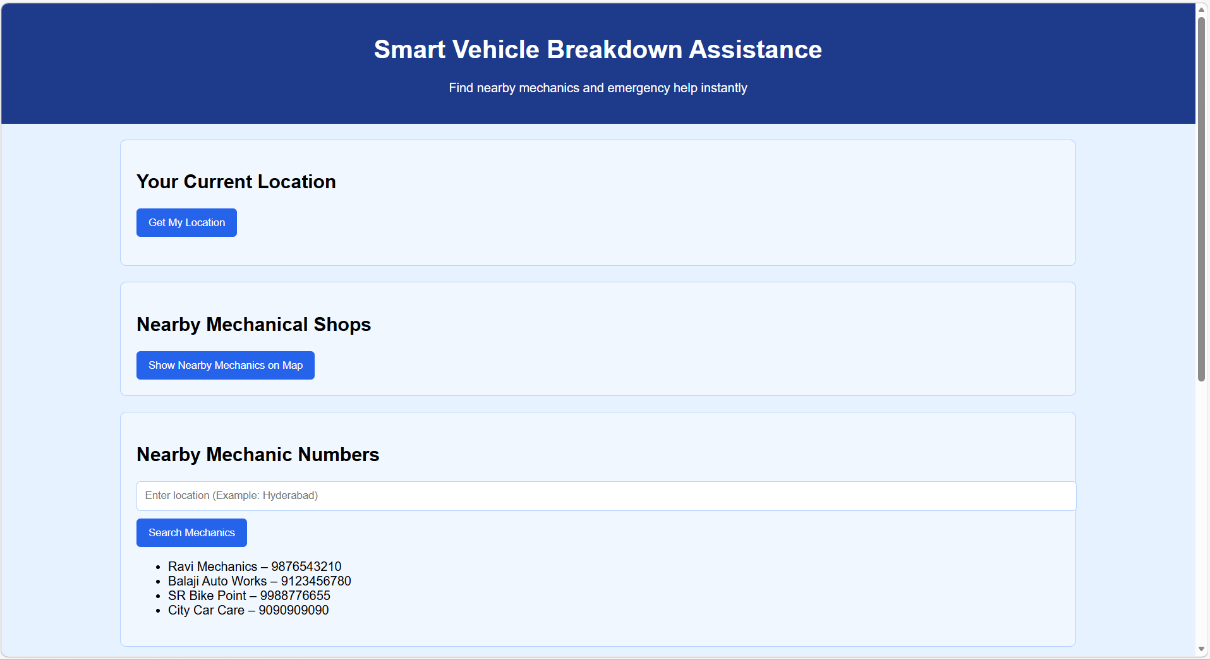
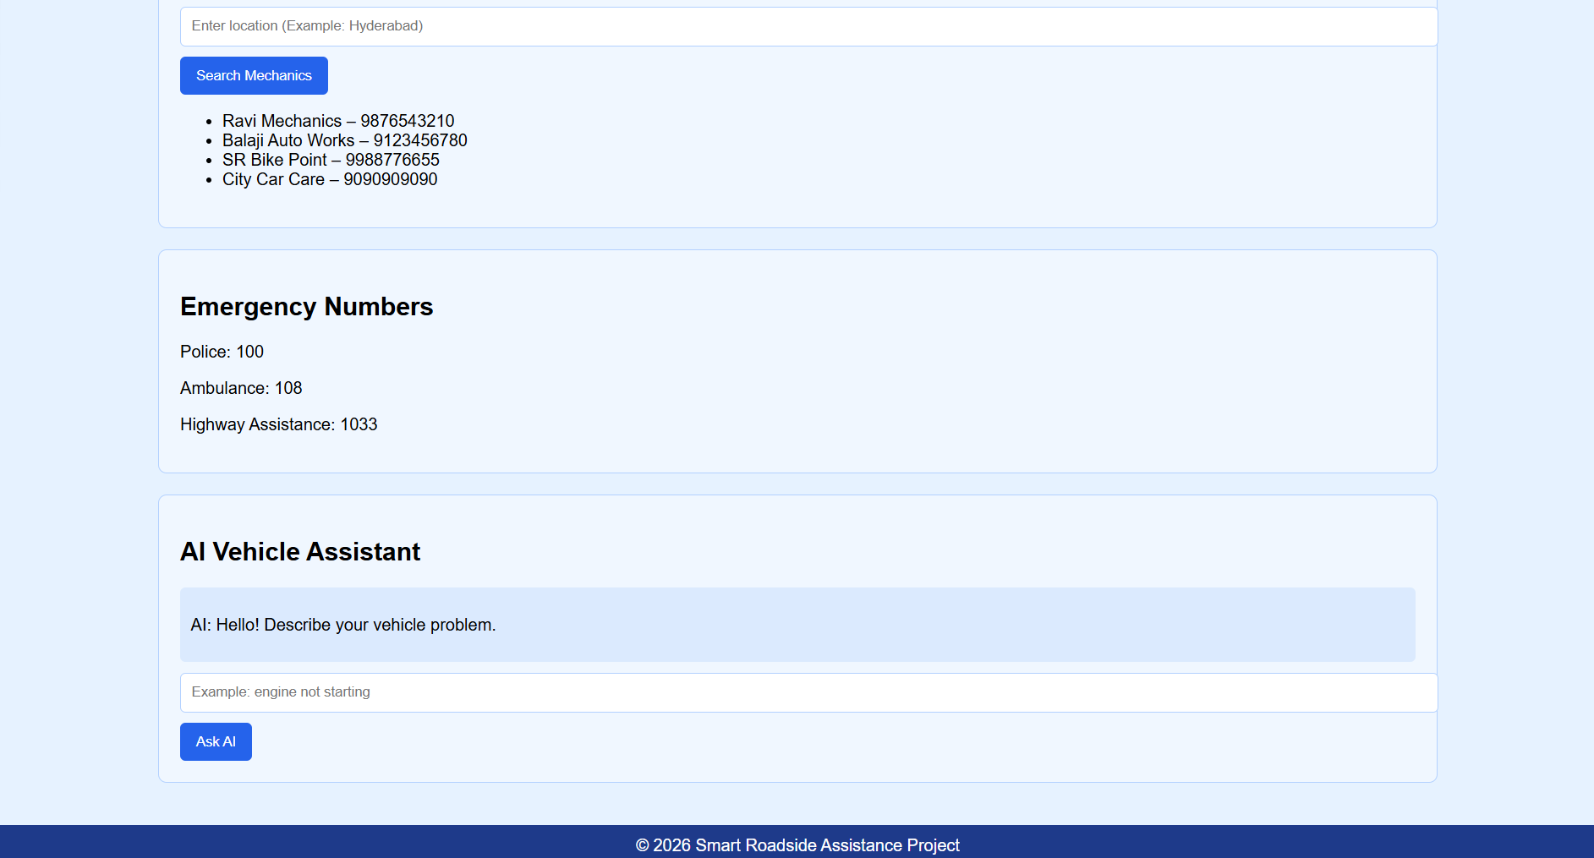
Screenshots for FWD

Slide 14
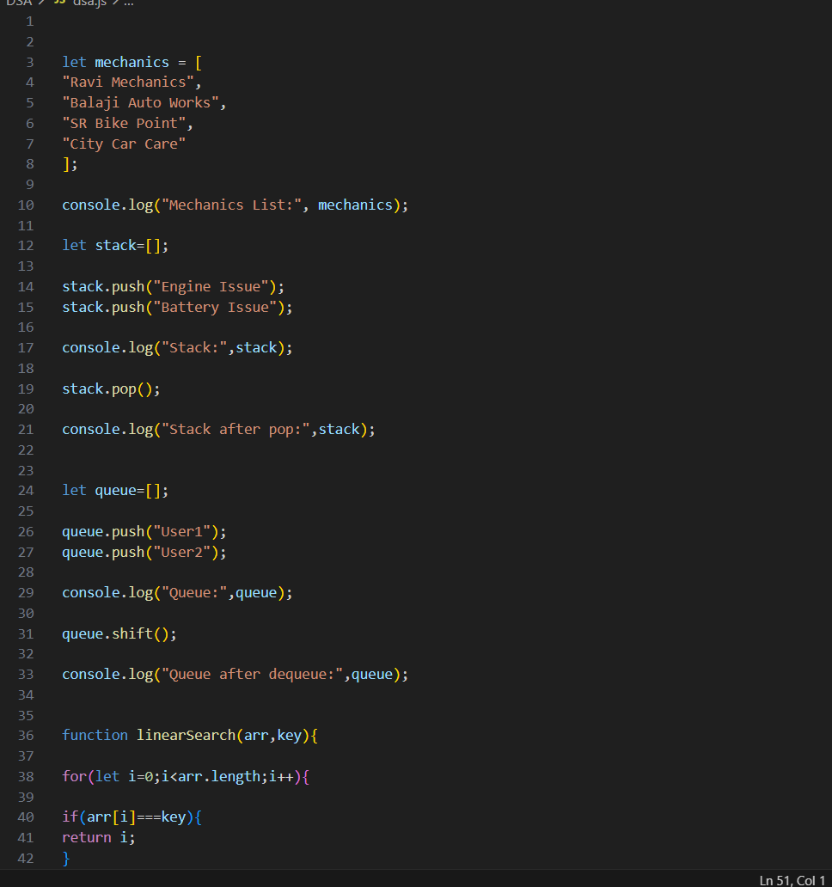
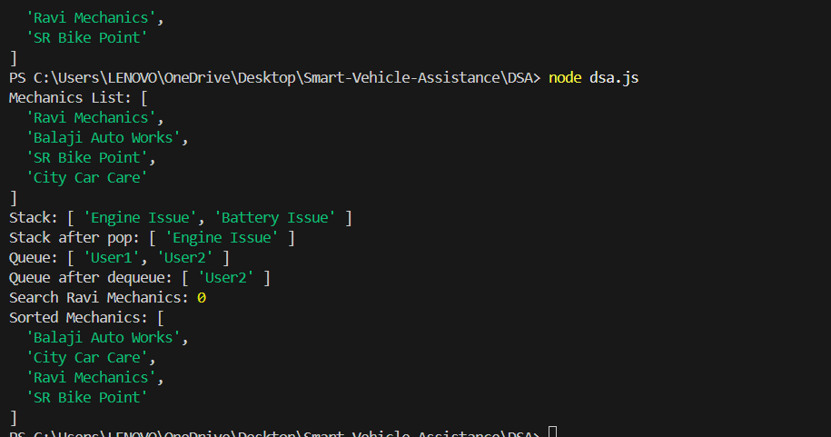
Screenshots for DSA

Slide 15
Conclusion
Developed a Smart Vehicle Breakdown Assistance System
Combines web technologies and data structures
Provides quick and reliable roadside assistance
Efficient data handling using DSA algorithms
Helps drivers handle breakdown situations easily

Slide 16
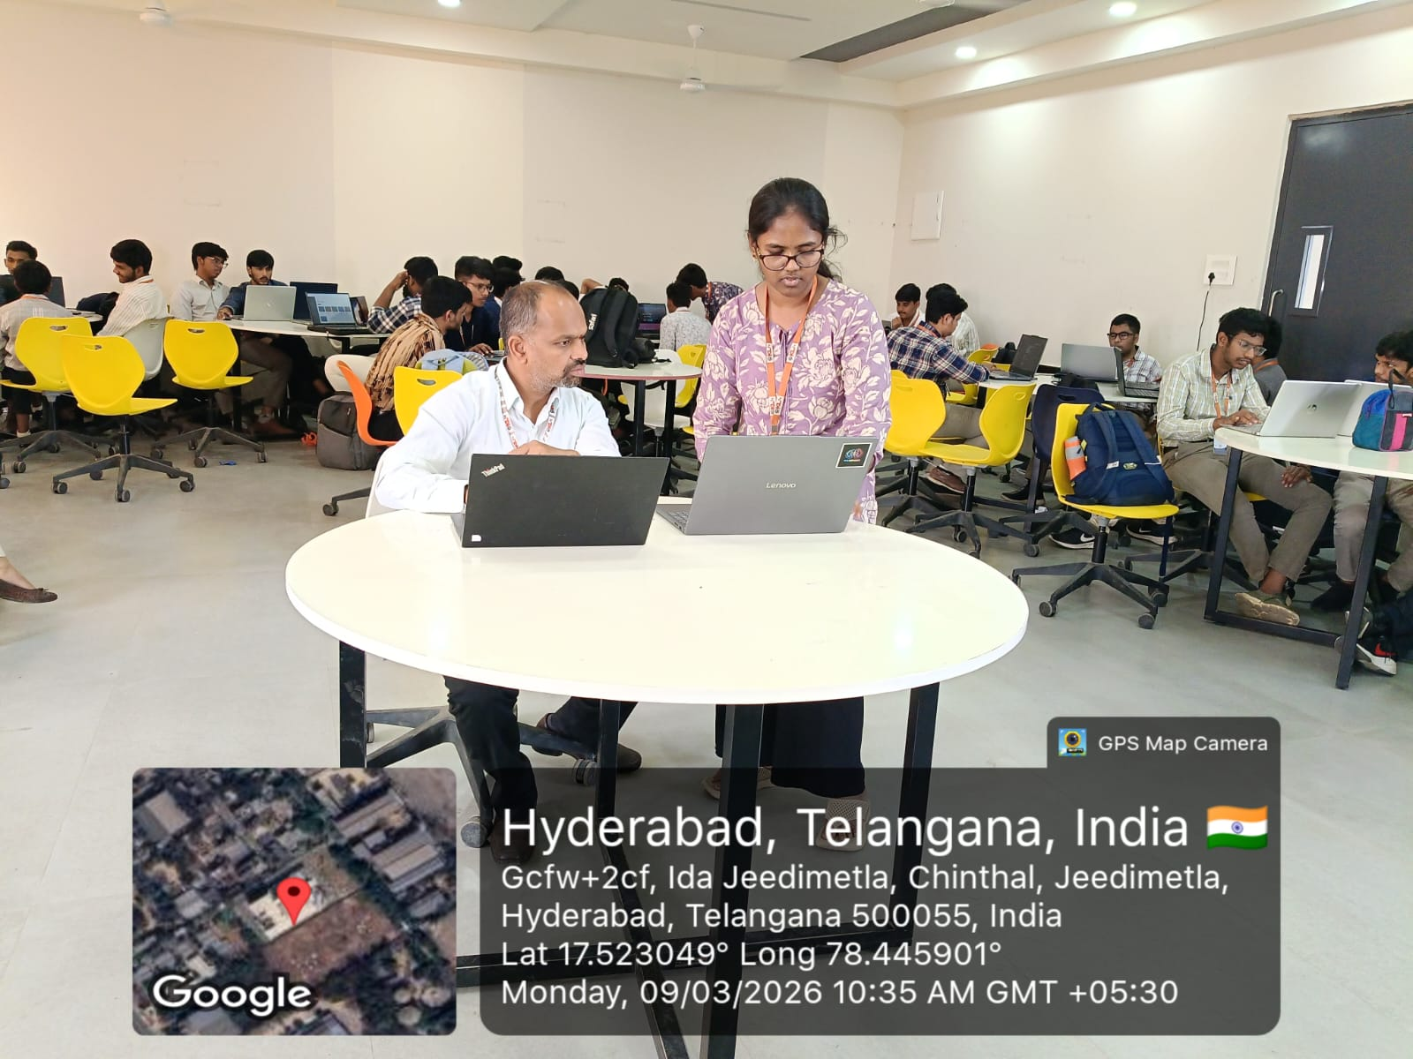
Geo- Tag Photos

Slide 17
THANK YOU

